Slide 1
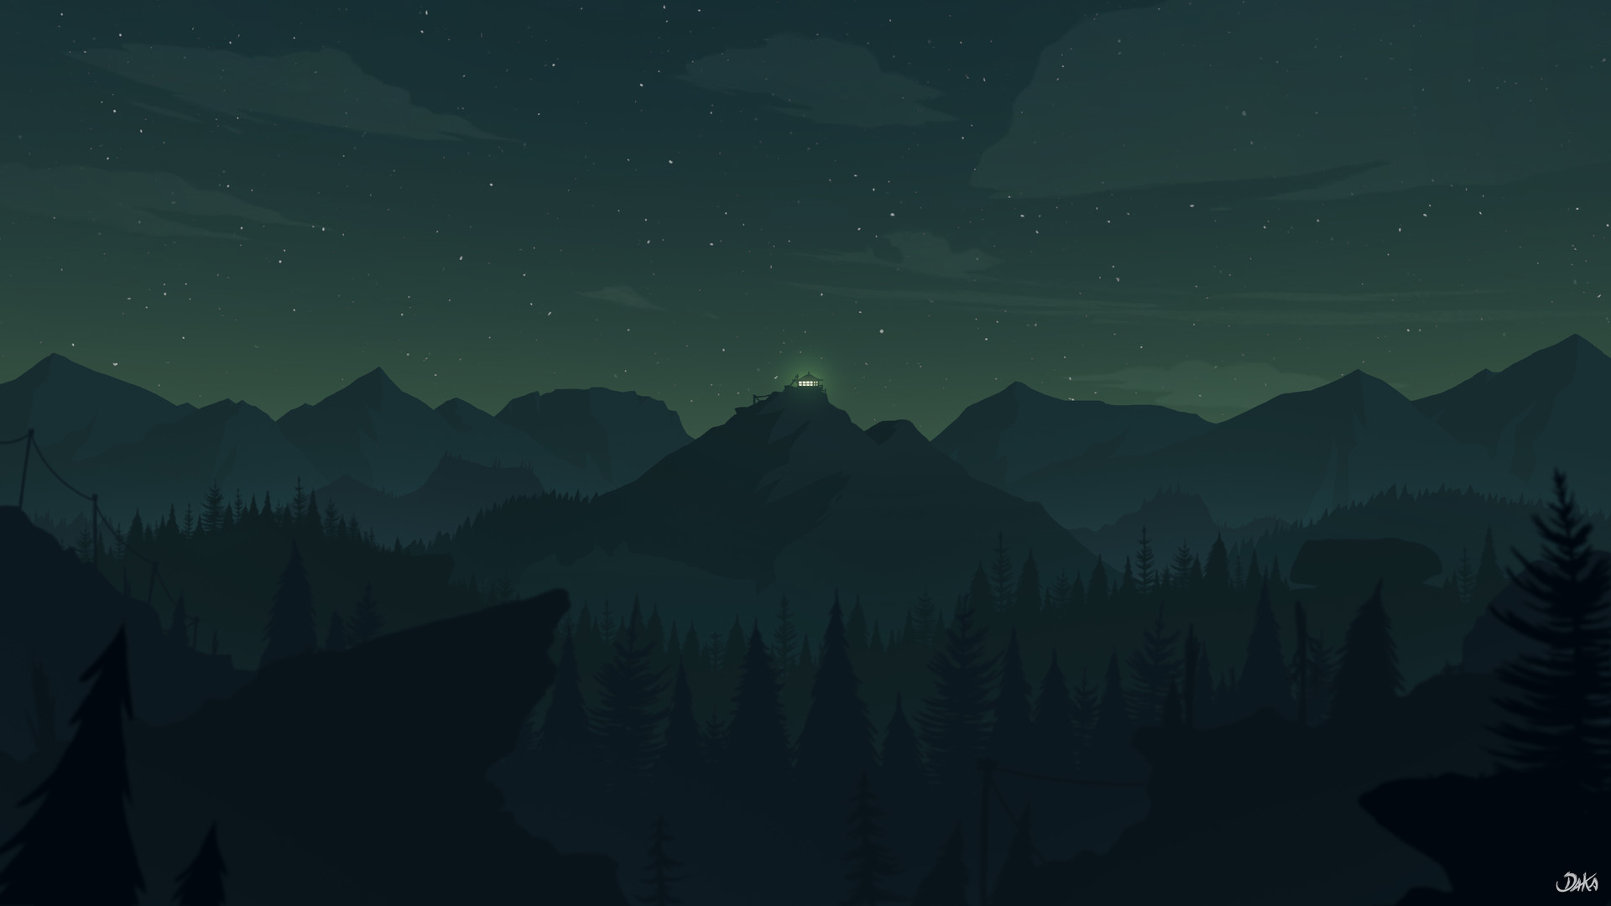
Fox’s Tale
Md. Tariquzzaman (190041101)
Tasnimul Hasnat (190041113)
Md. Irfanur Rahman Rafio (190041125)
Md. Jubayer Islam (190041129)

Slide 2
The inspiration of the project
One thing that old classic games did so well was that they were so simple and yet much fun to play. Such a game was Rapid Roll. But as of now, there is no PC version of the game. If we want to play the game, we need to use emulators which is not optimal at all. So we decided to create our own version of it with our own twists and turns, something that is handcrafted by us.

Slide 3
The Structure of the Game

Slide 4
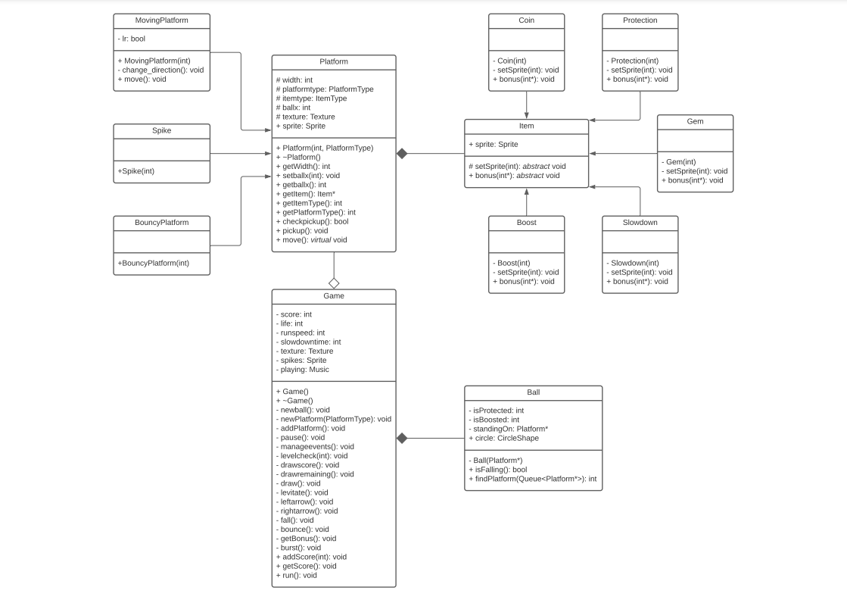
The UML Diagram

Slide 5
OOP Features
Feature | Where Used
Encapsulation+ Restricted Access+ Data Hiding | All classes
Constant functions and parameters | Various functions
Function overloading | Geme::newPlatform()
Operator overloading | Queue
Friend Function and Class | Ball, Item, Game
Inheritance | Item, Platform
Virtual functions | Item, Platform
Abstract functions | Item
File operation | High Scores
Template | Queue
Exception | Queue, Game::newball()
RTTI | Ball::findPlatform()
Enumerations | PlatfromType, ItemType
Pointers | Item::bonus()
References | Every function where an object is used as a parameter
Multi-file system: Extern variables | misc.cpp

Slide 6
The Build File
(Compilation and linking)
function compilation{
echo "........compilling.........."
g++ -c .\src\*.cpp -I.\include
echo ".........linking............"
g++ -o RapidRoll .\*.o -L.\lib -lsfml-graphics -lsfml-audio -lsfml-window -lsfml-system -mwindows
echo "..........moving............"
#Move-Item -Path *.o -Destination .\obj -force
mv .\RapidRoll.exe .\bin -force
echo "...........done............."
}

Slide 7
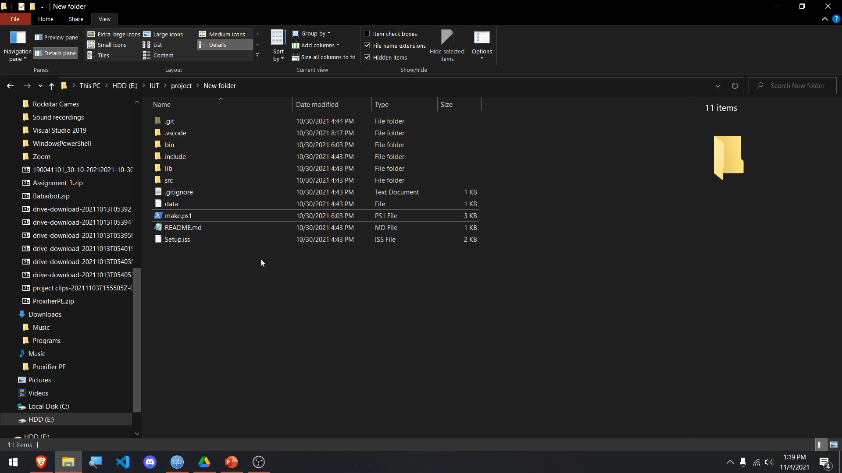

Slide 8
The Loading Screen
#ifndef MISC_H
#define MISC_H
//..
extern int bg;
extern sf::RenderWindow window;
extern sf::Event event;
extern sf::Clock clk;
extern sf::Music music;
//..
void icon();
void intro();
void drawbg();
void drawframe();
//..

Slide 9


Slide 10
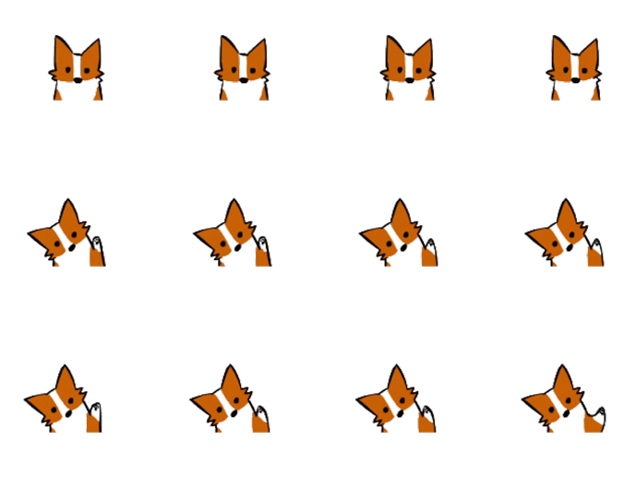
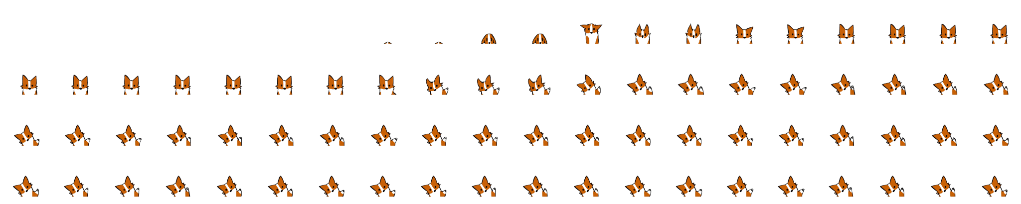
How
The frames
are animated

Slide 11
The Main Menu
void menu()
//...
window.clear();
drawbg();
window.draw(rect);
text[active].setFillColor(selected);
for (i = 0; i < 5; i++)
window.draw(text[i]);
window.display();
//…
Int main()
while (window.isOpen())
{
choice = menu();
if (choice == 1)//..
else if (choice == 2)//..
else if (choice == 3)//..
else if (choice == 4)//..
}

Slide 12
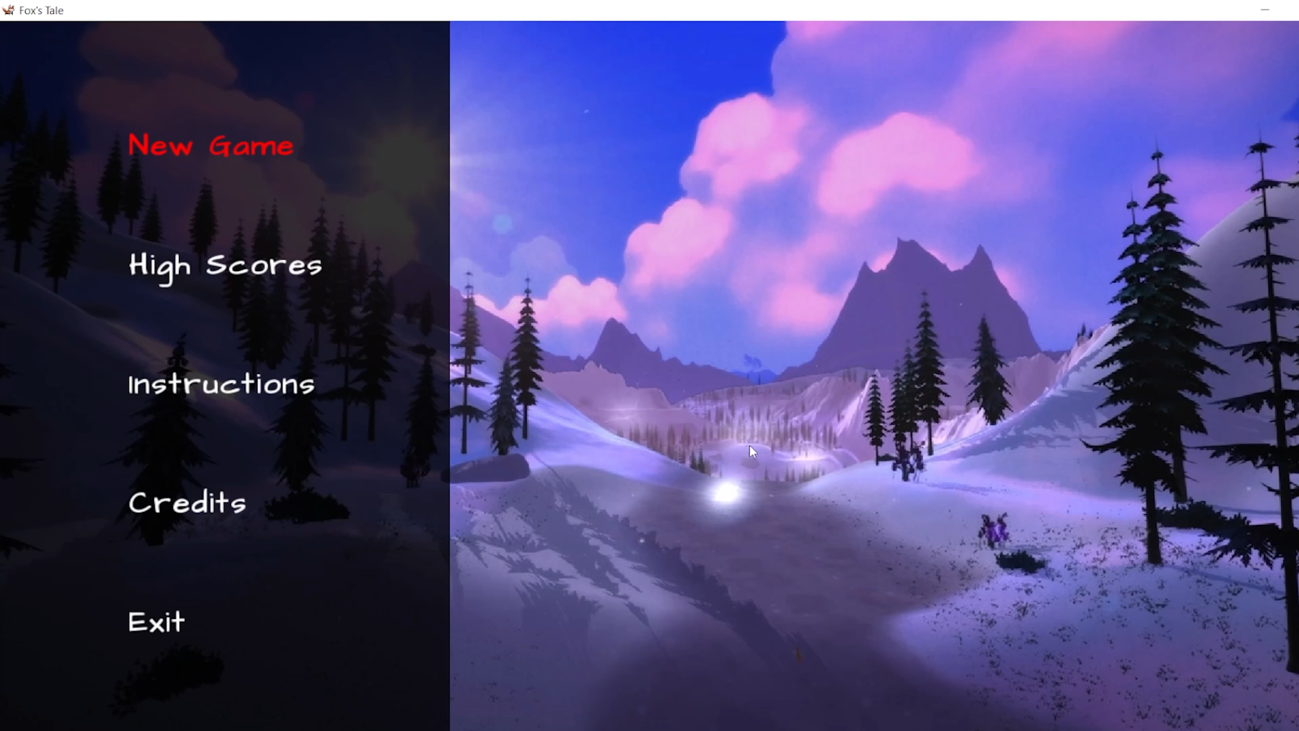

Slide 13
The Game Class
(Include files)
#ifndef GAME_H
#define GAME_H
#include "SFML/Graphics.hpp"
#include "SFML/Audio.hpp"
#include "Queue.hpp"
#include "Ball.hpp"
#include "Platform.hpp"
#include "Spike.hpp"
#include "MovingSpike.hpp"
#include "MovingPlatform.hpp"
#include "BouncyPlatform.hpp"

Slide 14
The Game Class
(Private variables and functions)
class Game
{
private:
int score, life, runspeed, slowdowntime;
Queue platforms;
Ball *ball;
sf::Texture texture;
sf::Sprite spikes;
sf::Music playing;
void newball();
void newPlatform(PlatformType);
void addPlatform();
void manageevents();
void pause();
void levelcheck(int);
void drawscore() const;

Slide 15
The Game Class
(Private functions continued and friend functions)
class Game
{
private:
//..
void drawremaining() const;
void draw();
void levitate(const int);
void leftarrow();
void rightarrow();
void fall();
void bounce();
void getBonus();
void burst();
friend void Coin::bonus(int *_score);
friend void Gem::bonus(int *_life);
friend void SlowDown::bonus(int *_runspeed);
//..

Slide 16
The Game Class
(Public functions)
class Game
{
private:
//..
public:
Game();
~Game();
void addScore(int);
int getScore() const;
void run();
};
#endif

Slide 17
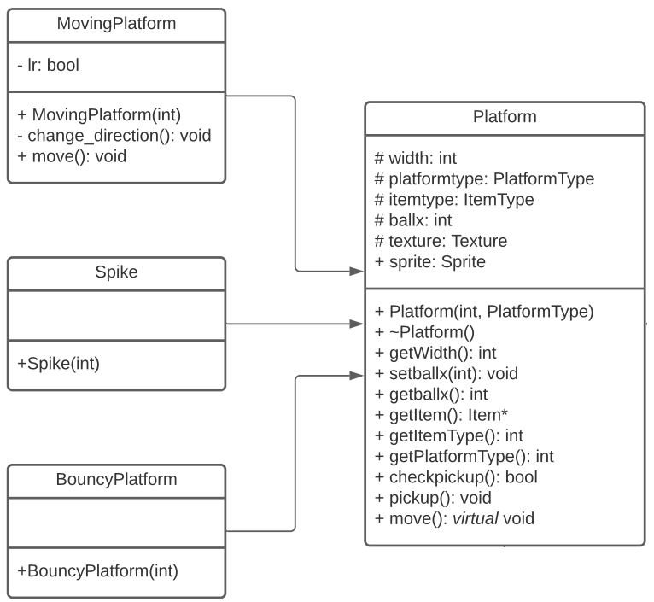
The Platform Class

Slide 18
The Platform Class
(Protected)
class Platform
{
protected:
int width, ballx;
Item *item;
PlatformType platformtype;
ItemType itemtype;
sf::Texture texture;

Slide 19
The Platform Class
(Public)
public:
sf::Sprite sprite;
Platform(int, const ItemType);
~Platform();
int getWidth() const;
void setballx(int);
int getballx() const;
Item* getItem() const;
int getItemType() const;
int getPlatformType() const;
bool checkpickup() const;
void pickup();
virtual void move()
{
sprite.move(0, -20);
if(item) item->sprite.move(0, -20);
}
};
#endif

Slide 20
The Spike Class
(Inherited)
class Spike : public Platform
{
public:
Spike(int);
};
Spike::Spike(int x) : Platform(x, nothing)
{
platformtype=spike;
width=width/8*8; texture.loadFromFile("data/img/Spikes.png");
sprite.setTexture(texture);
sprite.setTextureRect(sf::IntRect(0, 0, width, 10));
}

Slide 21
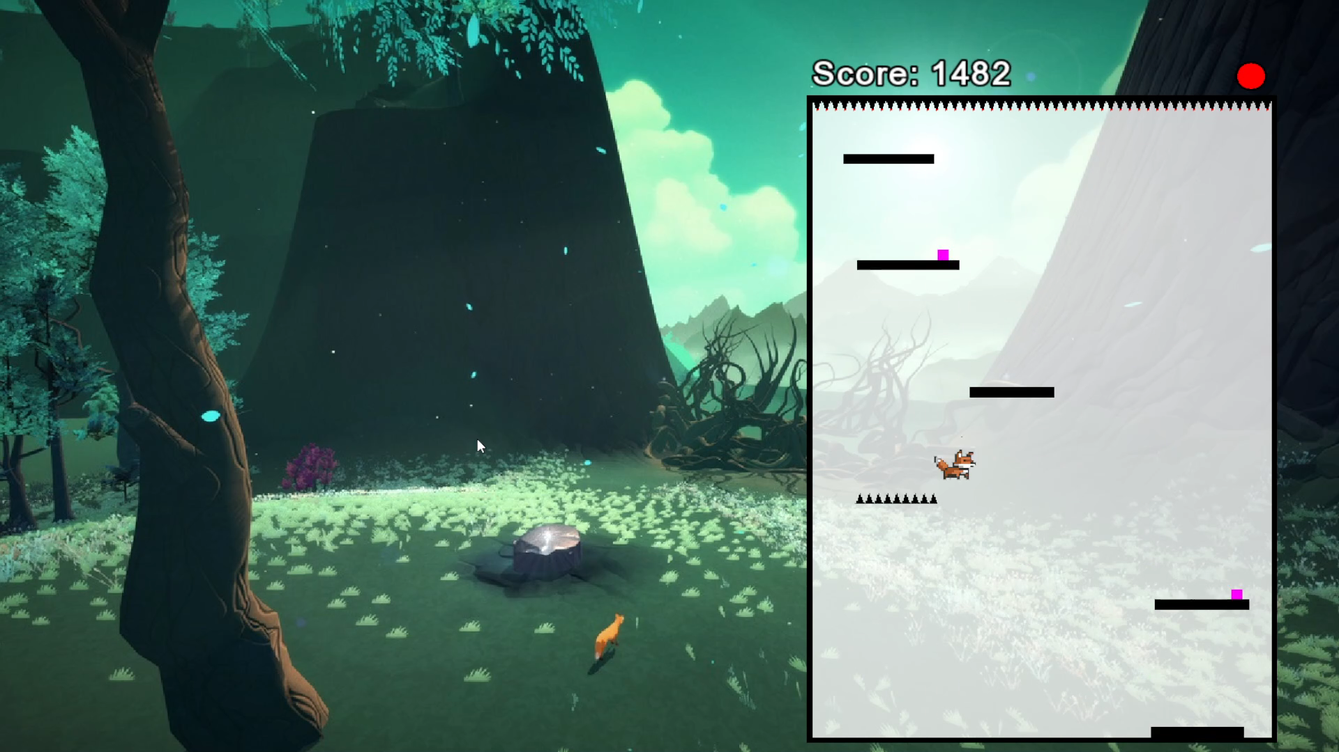

Slide 22
The Bouncy Platform Class
(Inherited)
class BouncyPlatform : public Platform
{
public:
BouncyPlatform(int);
};
BouncyPlatform::BouncyPlatform(int x): Platform(x, nothing)
{
platformtype=bouncing;
texture.loadFromFile("data/img/Platform.jpg");
sprite.setTexture(texture);
sprite.setTextureRect(sf::IntRect(0, 0, width, 10));
sprite.setColor(sf::Color(255, 120, 31));
}

Slide 23
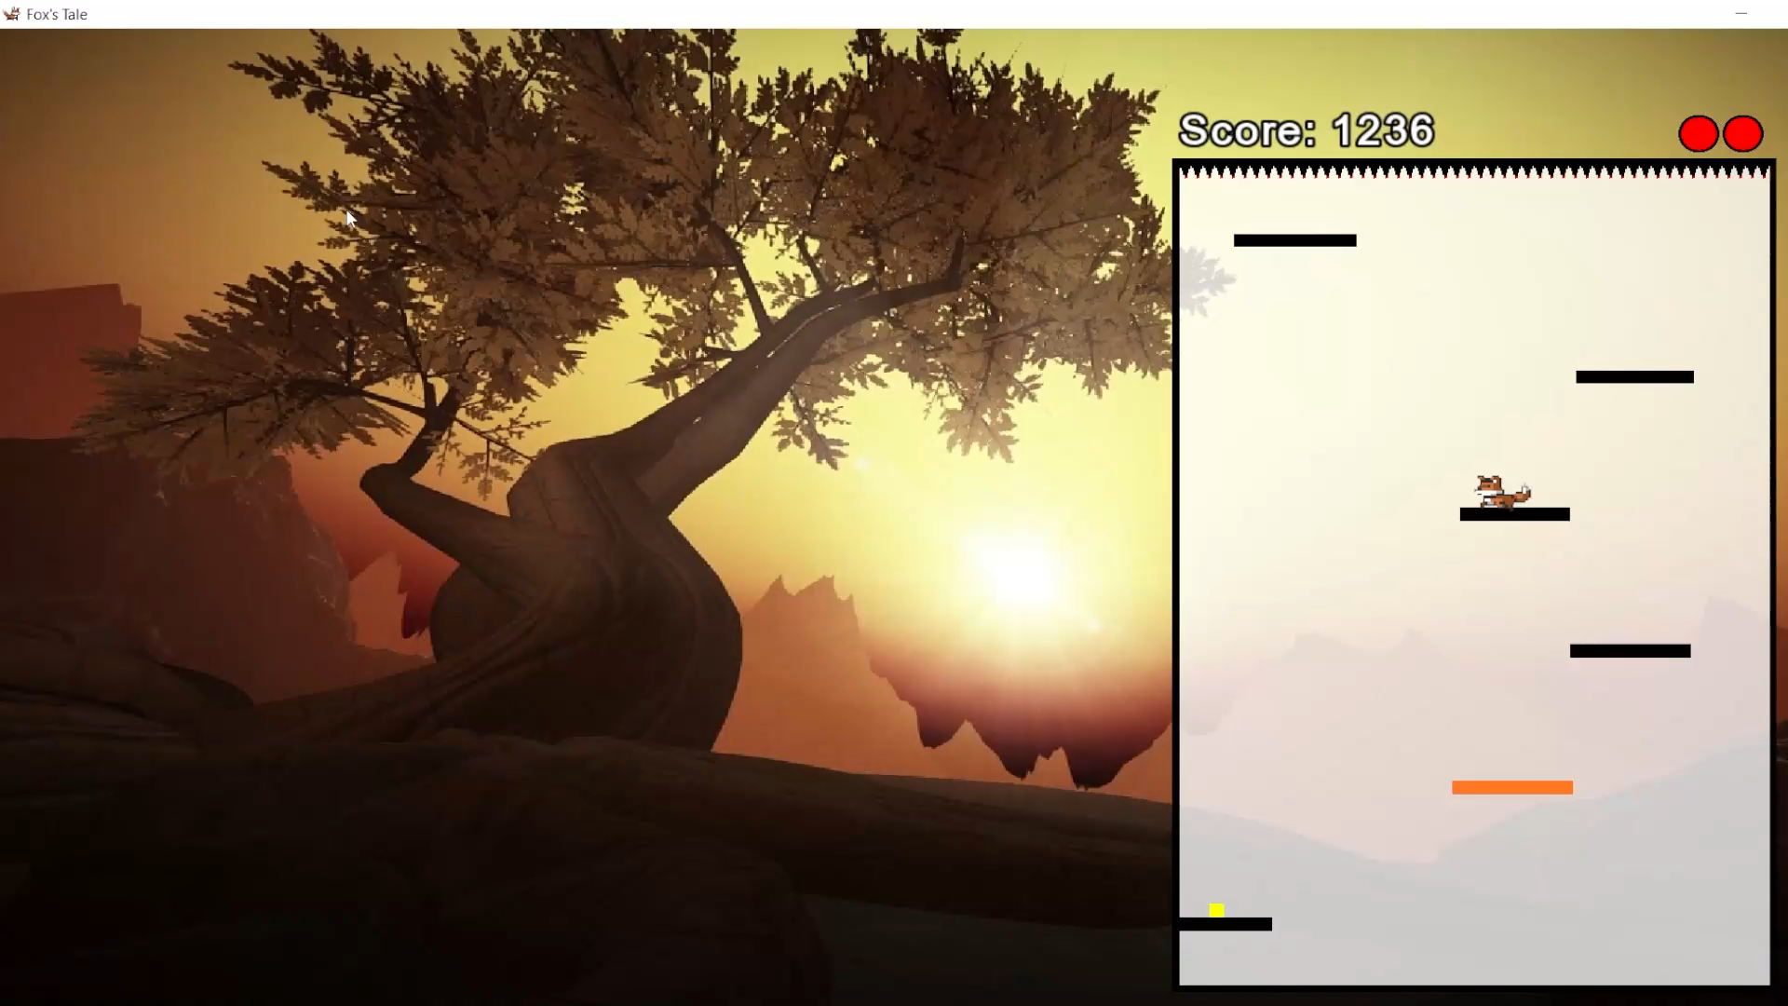

Slide 24
The Moving Platform Class
(Inherited)
class MovingPlatform : public Platform
{
private:
bool lr; // Direction of movement- 0 for left and 1 for right
void change_direction();
public:
MovingPlatform(int, const ItemType);
void move();
};

Slide 25
The Moving Platform Class
(Inherited)
MovingPlatform::MovingPlatform(int x, const ItemType _itemtype): Platform(x, _itemtype), lr(rand()&1)
{
platformtype=moving;
}
void MovingPlatform::move()
{
//..
}
void MovingPlatform::change_direction()
{
lr=!lr;
}

Slide 26
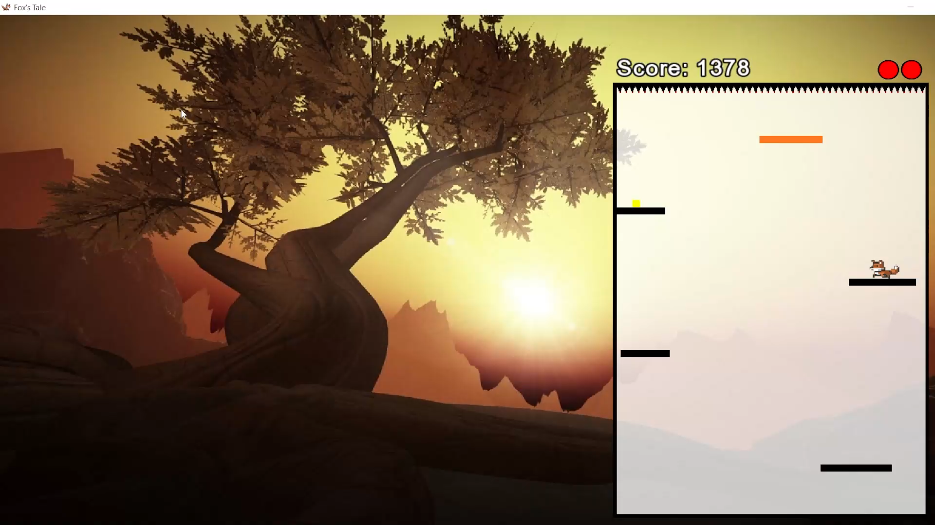

Slide 27
Creating the platform
(In the Game class)
void Game::newPlatform(PlatformType platformtype = regular)
{
//…
switch(platformtype)
{
//..
}
}

Slide 28
Creating the platform
(contd.)
case regular:
platforms.enqueue(new Platform(800+temp, itemtype));
break;
case spike:
platforms.enqueue(new Spike(800+temp));
break;
case moving:
platforms.enqueue(new MovingPlatform(800+temp, itemtype));
break;
case movingspike:
platforms.enqueue(new MovingSpike(800+temp));
break;
case bouncing:
platforms.enqueue(new BouncyPlatform(800+temp));
break;

Slide 29
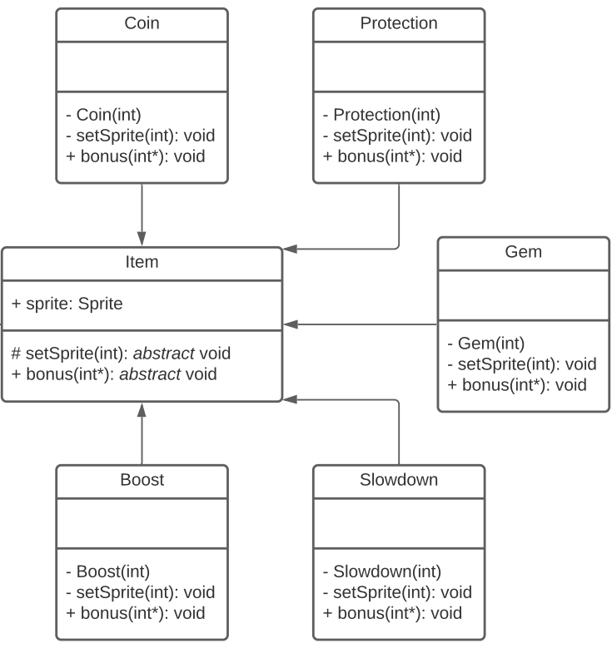
The Item Class

Slide 30
The Item Class
class Item
{
protected:
virtual void setSprite(const int)=0;
public:
sf::Sprite sprite;
virtual void bonus(int*)=0;
};

Slide 31
The Coin Class
(Inherited)
class Coin : public Item
{
friend class Platform;
Coin(int);
void setSprite(const int);
public:
void bonus(int *);
};
//..
void Coin::bonus(int *_score)
{
*_score+=100+rand()%200;
}

Slide 32
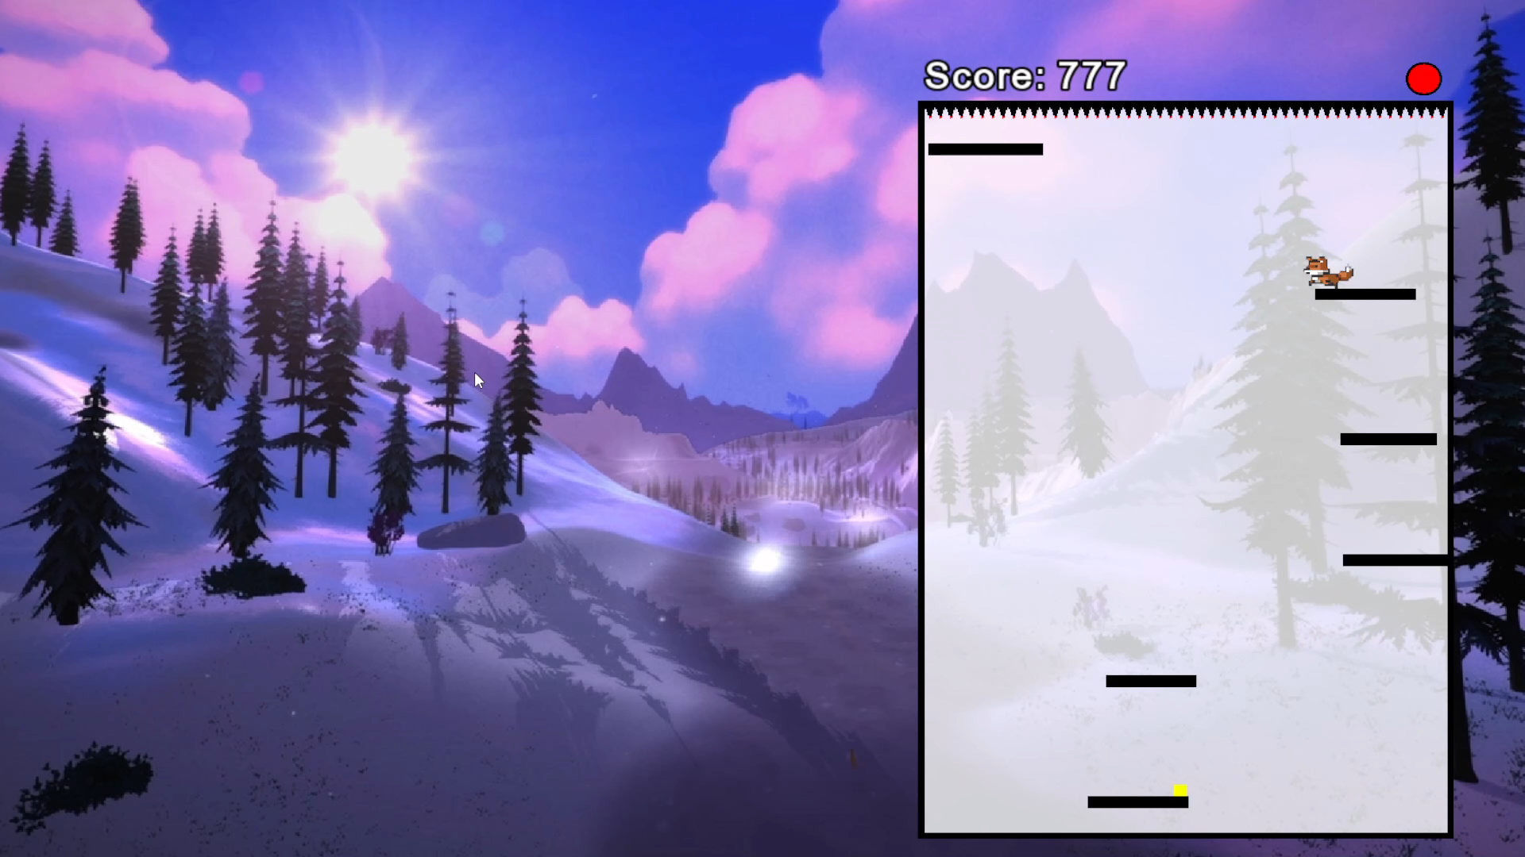

Slide 33
The Protection Class
(Inherited)
class Protection : public Item
{
friend class Platform;
Protection(int);
void setSprite(const int);
public:
void bonus(int *);
};
//..
void Protection::bonus(int *_protection)
{
*_protection+=19+(rand()&31);
}

Slide 34
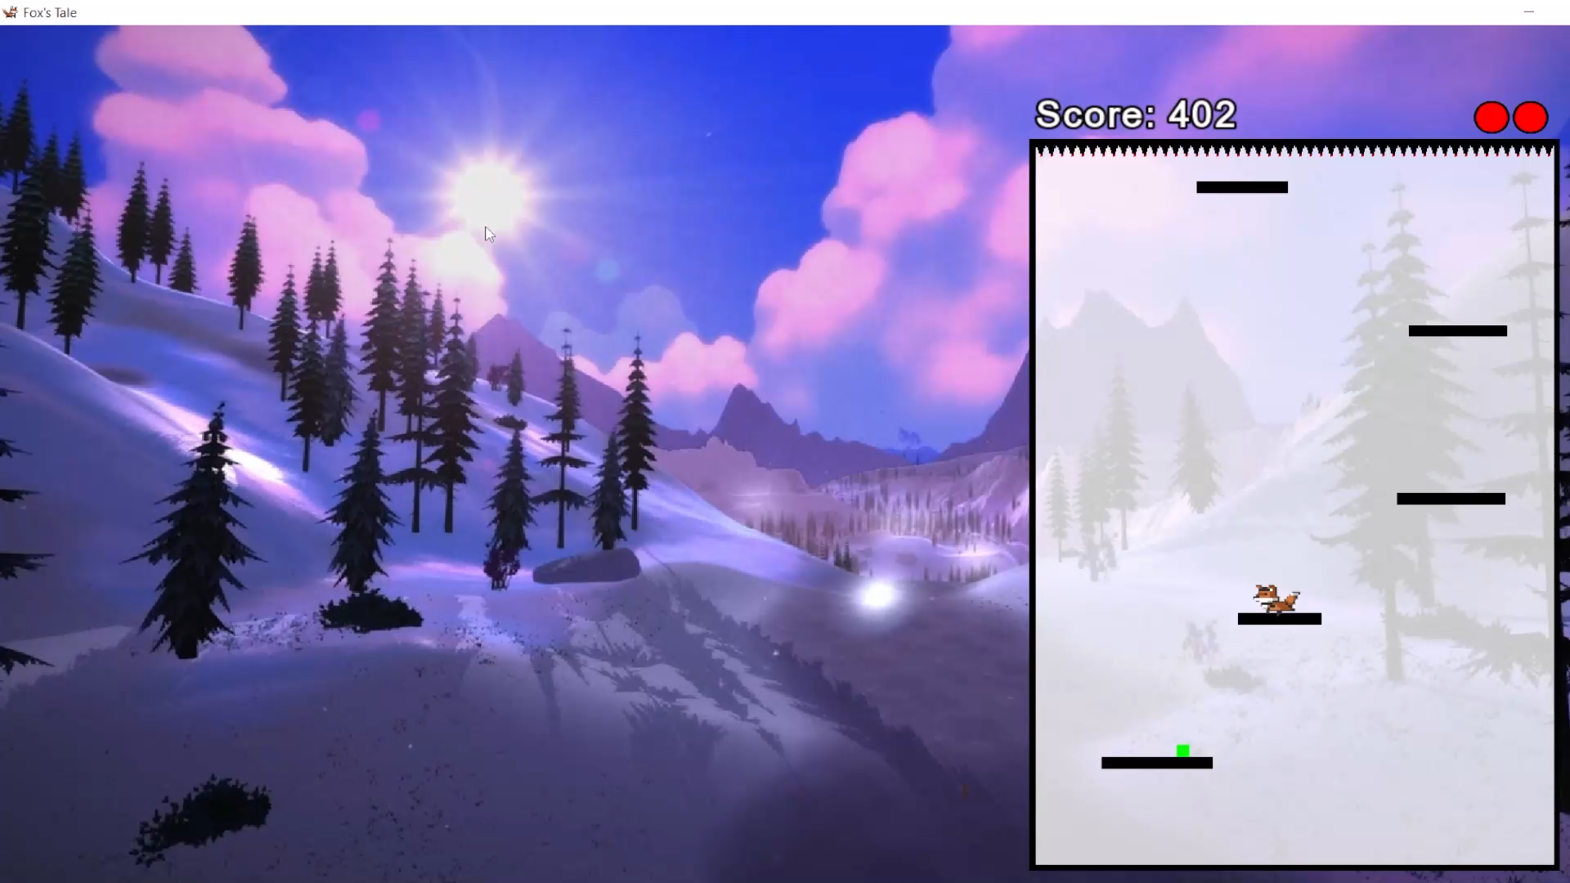

Slide 35
The Gem Class
(Inherited)
class Gem : public Item
{
friend class Platform;
Gem(int);
void setSprite(const int);
public:
void bonus(int *);
};
//..
void Gem::bonus(int *_life)
{
*_life=std::min(*_life+1, 6);
}

Slide 36
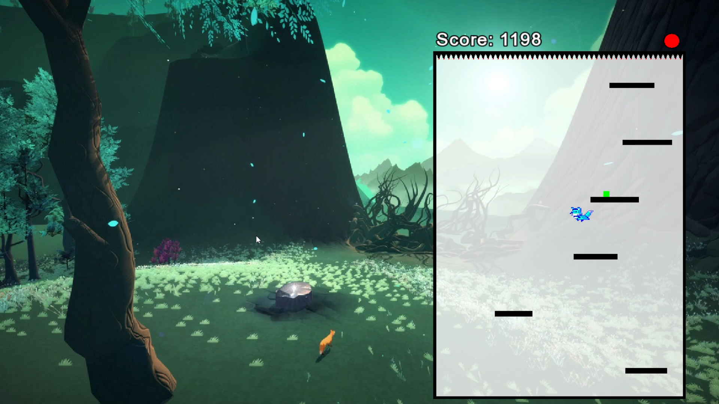

Slide 37
The Slowdown Class
(Inherited)
class SlowDown : public Item
{
void setSprite(const int);
public:
SlowDown(int);
void bonus(int*);
};
//..
void SlowDown::bonus(int *_slowdowntime)
{
*_slowdowntime+=19+(rand()&31);
}

Slide 38
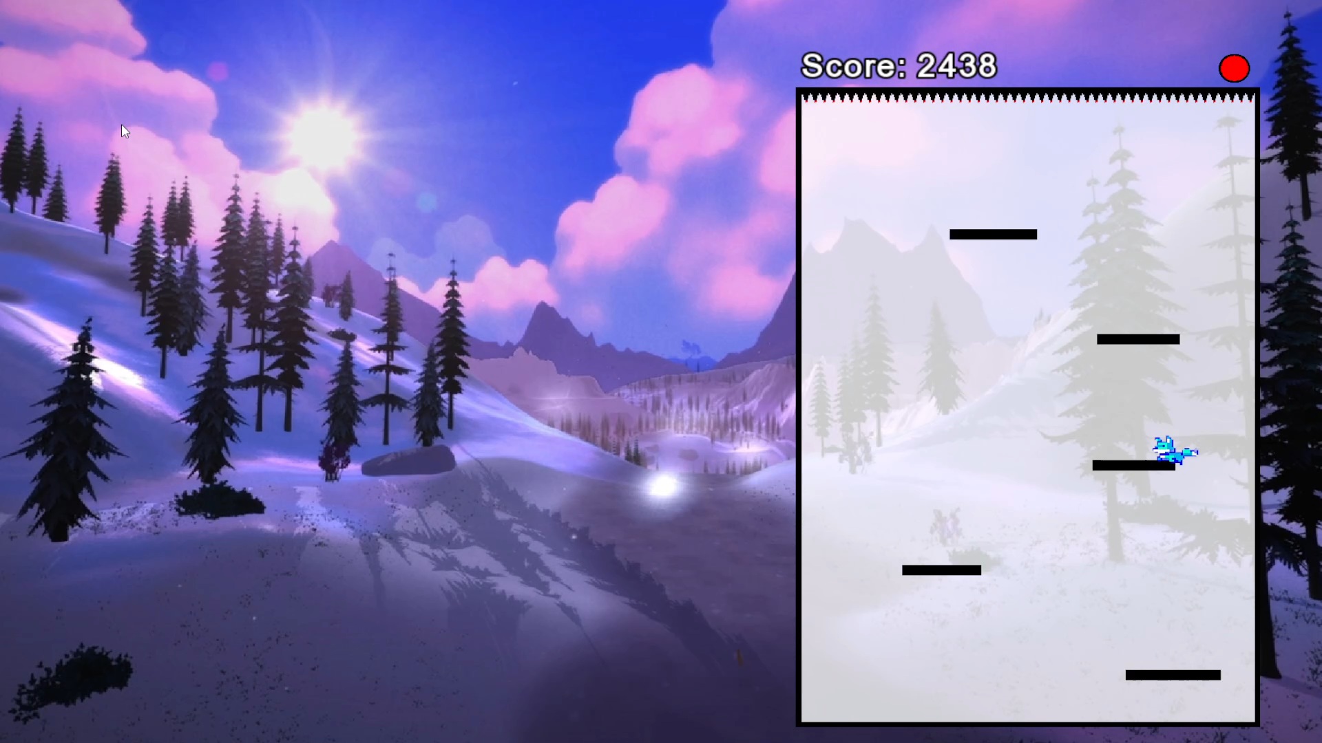

Slide 39
The Boost Class
(Inherited)
class Boost : public Item
{
friend class Platform;
Boost(int);
void setSprite(const int);
public:
void bonus(int *);
};
void Boost::bonus(int *_isBoosted)
{
*_isBoosted+=19+(rand()&31);
}

Slide 40
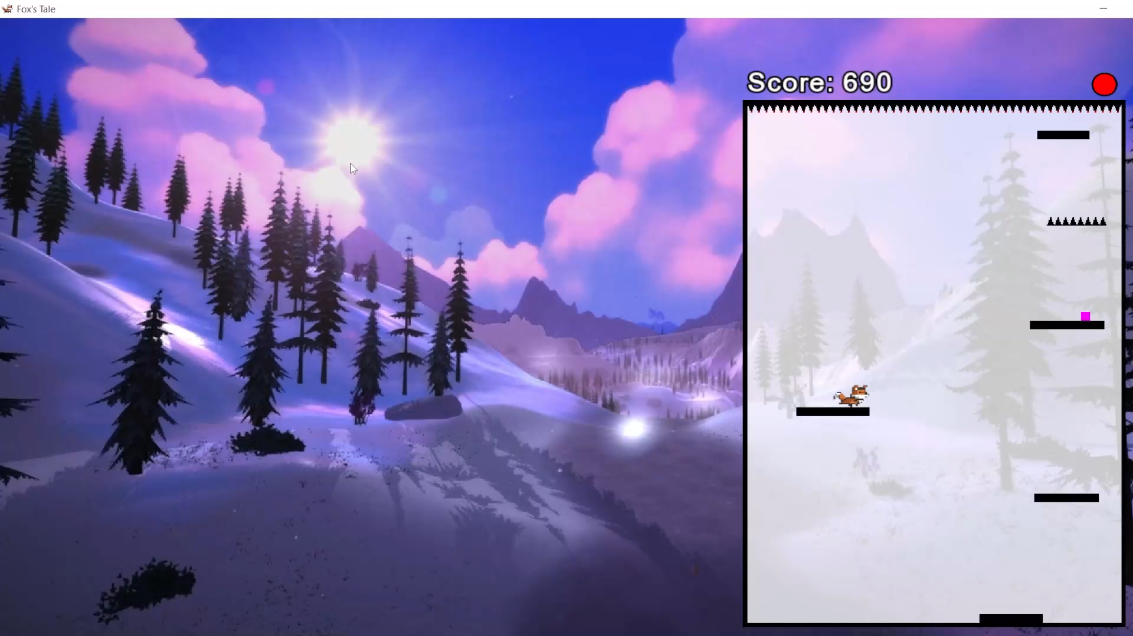

Slide 41
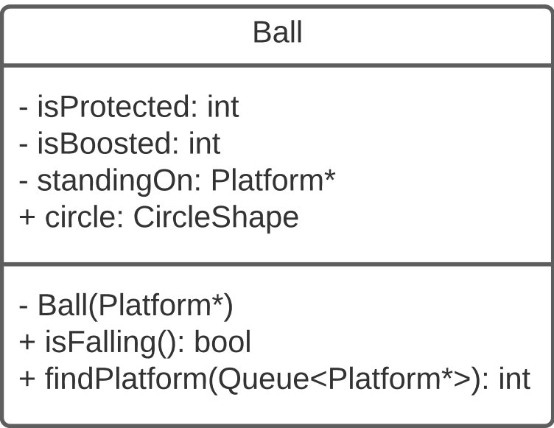
The Ball Class

Slide 42
The Ball Class
class Ball
{
int isProtected, isBoosted;
Platform *standingOn;
Ball(Platform *);
friend class Game;
friend void Boost::bonus(int *_isBoosted);
friend void Protection::bonus(int *_isProtected);
public:
sf::Texture texture;
sf::Sprite fox;
bool isFalling() const;
int findPlatform(Queue<Platform *> &);
};

Slide 43
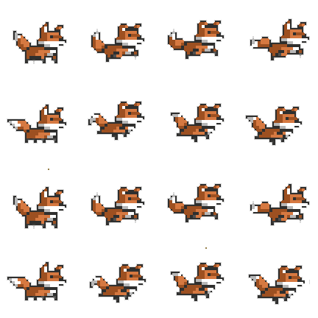
Fox Movement Animation

Slide 44
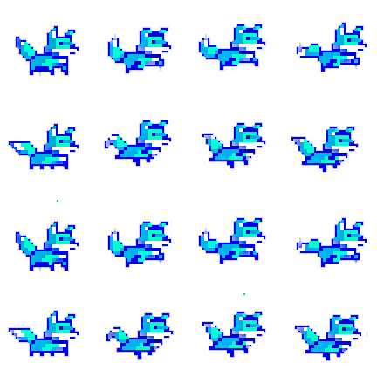
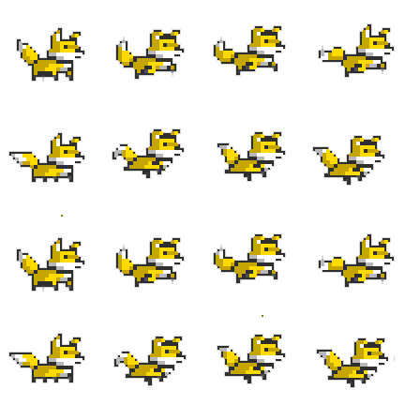
Fox Color Shift

Slide 45
Reading Highscores from a file
void readrecords(std::set<std::pair<int, std::string>> &records, std::ifstream &fin)
{
for (int i = 0; i < 10; i++)
{
if (!fin)
return;
int score;
std::string name;
char temp;
fin >> score;
fin >> temp;
if (!fin)
return;
std::getline(fin, name, '#');
records.insert({score, name});
}
}

Slide 46
Adding New Score
std::set<std::pair<int, std::string>> records;
std::ifstream fin("data/High_Score.txt");
readrecords(records, fin);
fin.close();
//..
records.insert({game.getScore(), scanfromscreen(text, sf::IntRect(810, 110, 200, 40))});
//..
if (score > records.begin()->first){
drawrecord(score);
}

Slide 47
Adding New Score
void drawrecord(int score)
{
drawbg();
drawframe();
sf::Text text;
text.setFont(arial);
text.setString("New High Score: " + std::to_string(score) + "\nEnter Your Name");
text.setCharacterSize(30);
text.setFillColor(sf::Color::White);
text.setOutlineThickness(2);
text.setOutlineColor(sf::Color::Black);
text.setStyle(sf::Text::Bold);
text.setPosition(800, 25);
window.draw(text);
}

Slide 48
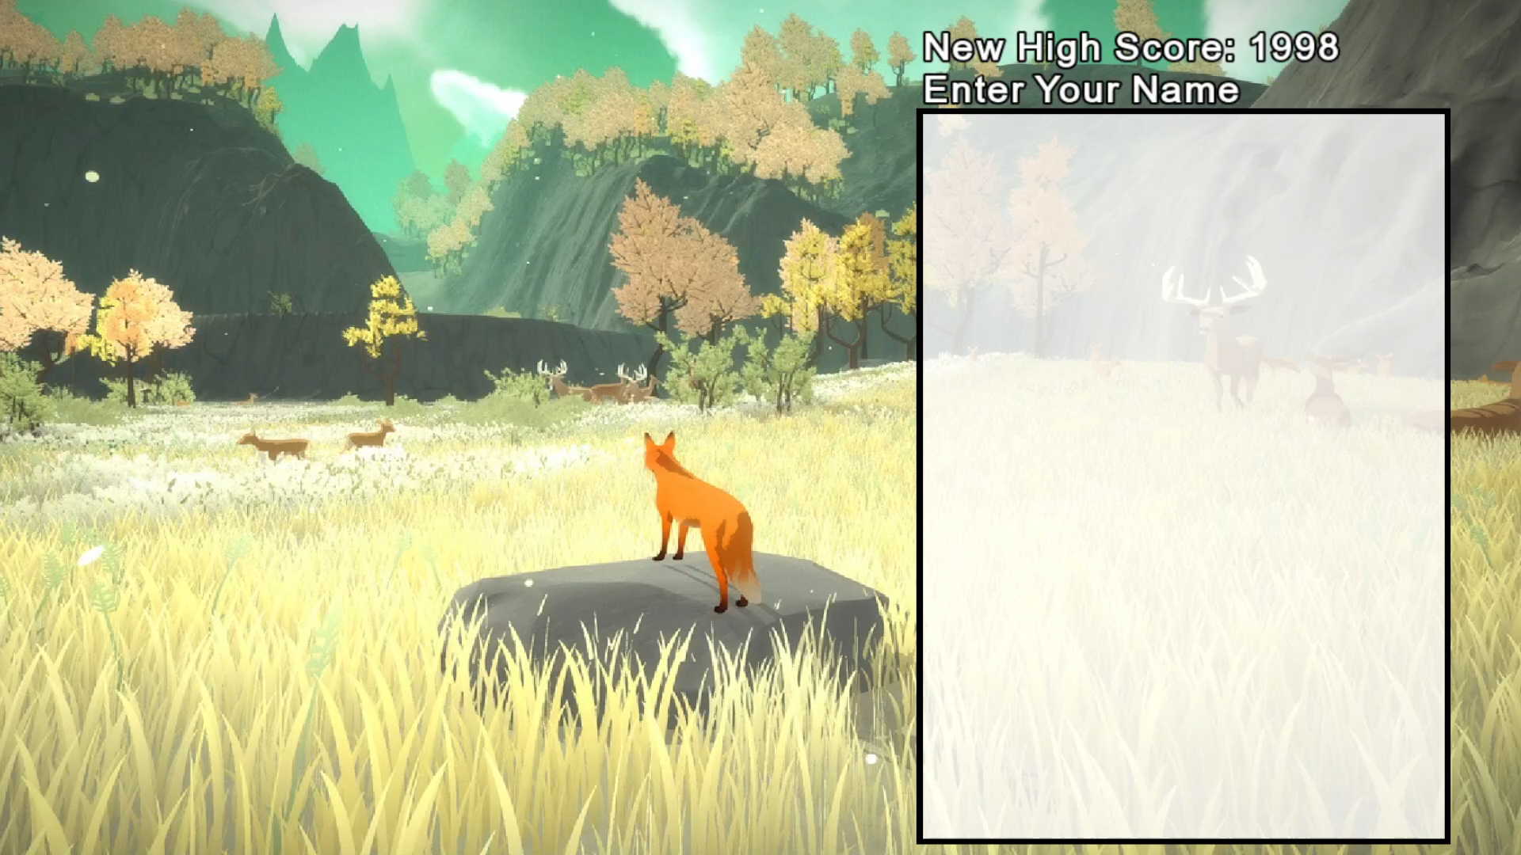

Slide 49
Part of Project | Group Member
Story and Concept | Tariq+Jubayer
Planning and Scheduling | Tariq
Version Control (Github) | Ork
Github Colaboration | Everyone
Basic Game Mechanics | Ork+Rafio
Graphics Resources | Tariq+Jubayer
Fox Collision detection | Tariq+Rafio
Animating the Fox, PowerUp Transitions | Tariq
Soundtrack Management | Tariq
Score and Level Management | Ork+Rafio
Class Designing | Rafio
Leaderboard Management | Jubayer
Intro | Tariq
Main Menu | Tariq+Rafio
Installer | Ork
Credits and Instructions | Ork
Multi-file system | Ork+Rafio
Debugging | Everyone
PowerPoint Presentation | Tariq
Gameplay Recording | Jubayer
Individual Contribution

Slide 50
Thank You

